Slide 1
Addressing the Invisible People:
Homeless Population In USA Analyzation
Hanyury Ascencio, Amari Colinares, LaKisha Collins-Mitchell, Leketa Hobbs, Jessica Jay-Sells
Entity X Woz U

Slide 2
Team Members

Slide 3

Hanyury Ascencio
Born in El Salvador
Migrated to USA in 1998
Fluent in English and Spanish
Graduated High School and went to College
Study Finances
Accounts Payable Specialist ( 7 years experience)
Current Employment in American Homes 4 Rent as an Invoice Coordinator.
Here, I have worked on a few projects that led me to be interested on Data Analysis.
Team Member

Slide 4

Amari Colinares
-Born in Staten Island, New York
-Graduate of the East Valley Institute of Technology’s Software Development Program
-Full-Time University Student pursuing a Bachelors in Psychological Sciences
Team Member

Slide 5

LaKisha Collins-Mitchell
I currently live in Los Angeles, CA. I love traveling and getting to know different cultures. I work as a data analyst with Los Angeles County Development Authority and I’m also a flight attendant with American Airlines. I have my Associates and Bachelors degree in Biology. My motto is Never Give Up!
Team Member

Slide 6

Leketa Hobbs
Born and Raised in Chicago
Currently working at U.S. Bank as an Account Representative.
Received my Associates, Bachelors, and Masters
Came across Data Science years ago, but never can find the time to pursue the industry until now
Team Member

Slide 7

Jessica Jay-Sells
Bachelor of Arts, General Studio Art, 2015
Bartender and Assistant Manager
Student, Stay at Home Wife & Mother
Was looking for new career & stumbled upon Data Scientist position
Skilled in: Mathematics, Fact Checking, Data Analysis, Learning Quickly, R & Python Languages, Microsoft Office apps
Team Member

Slide 8
Project Background and Intro

Slide 9
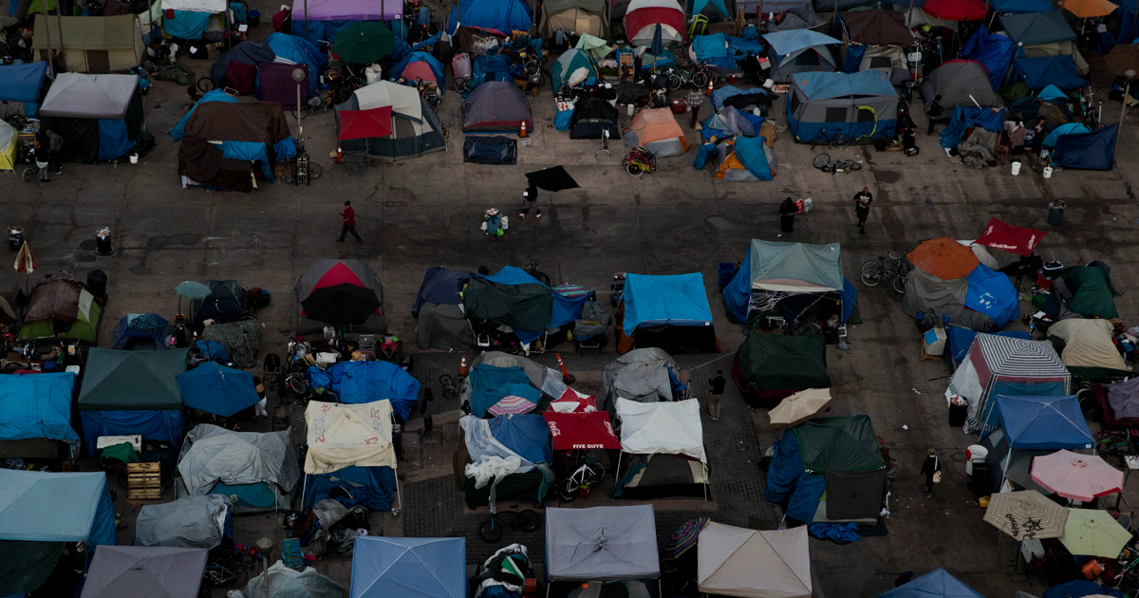
What is Homelessness?
Homelessness is a situation in which an individual or family lacks a stable, permanent residence such as those living in shelters or sleeping on the streets.
In most cases, homelessness is ultimately caused because an individual or family cannot afford stable or permanent housing.
The United States Department of Housing and Urban Development (HUD) defines people experiencing homelessness in these terms:
An individual who lacks a fixed, regular, and adequate nighttime residence;
An individual who has a primary nighttime residence that is a public or private place not designed for or ordinarily used as a regular sleeping accommodation for human beings, including a car, park, abandoned building, bus or train station, airport, or camping ground
An individual or family living in a supervised publicly or privately-operated homeless shelter designated to provide temporary living arrangements;
An individual who resided in a shelter or place not meant for human habitation and who is exiting an institution where he or she temporarily resided;
An individual or family who will ultimately lose their adequate housing (usually due to an eviction).
Notes:
HANYURY
What is Homelessness? - (neighbor.org)

Slide 10

Stats
There are over half a million people experiencing homelessness in the US.
Families with children makeup 30% of homeless persons.
According to the data, transgender people make up .5% of the general United States homeless population. 63% of them being unsheltered.
The number of Veterans who were homeless fell by almost 50% in the decade between 2009 and 2019.
Over a quarter of the homeless population resides in California.
Notes:
HANYURY

Slide 11
Evaluation Questions
What is a large contributor to the growing numbers of homeless persons in the US?
What are the demographics of the people most affected?
How has the Veteran Homeless population changed over the years?
What percentage of the U.S. homeless population is transgender and or gender non-conforming?
Is housing/shelters available for the homeless population? If so, What kind?
How does weather affect the homeless population?
Does your income indicate your risk for becoming homeless in the future?
Notes:
JESSICA
We have been trying to conclude contributions to the rising numbers of homelessness by looking into possible factors. “What is a large contributor to the growing numbers of homeless persons in the us?”
In order to really figure out the first answer, we knew we had to look deeper into the population as a whole. “What are the demographics of the people most affected?” Are we looking at veterans, the trans community, minorities, basically who are the homeless we are looking into? What do these community’s numbers look like? Then we needed to figure out why they are on the street Do they have a place to be? Are we offering enough assistance? “Is housing/shelters available for the homeless population? If so, what kind of housing are we offering?” We took a deep look into bed availability. Analyzing mostly the top 6 states affected, we have also studied weather, income variations, disabilities etc.

Slide 12
The Languages
Excel
Python
R
Tools
Jupyter Notebook
R*Studio
Visuals
Tableau
Notes:
JESSICA
As a team, we utilized all forms we were taught except SQL and Big Data softwares. We needed to take advantage of specific applications for most of our analyses. These included Excel, Python and R, which we formed in Notebooks of Jupyter Lab and R Studio. We also made sure we had plenty of visuals by creating plots and graphics in Tableau, Excel and our Notebooks.

Slide 13
Methods
Histograms
Pairplots
Pearson and other Correlations
Heatmaps
Normal Distribution
Mean and Averaging
K-Clusters
Chi-square
Machine Learning
Decision Trees
Notes:
JESSICA
Homelessness is a huge topic, therefore plenty of variables were explored in our 5 weeks of this project. We had to manipulate them in many ways to find the answers we needed.

Slide 14
The Data
There is no methodological consent on counting the homeless and their needs; thus in most cities only estimated homeless populations are known.
HUD
Census
CoC
NOAA
World Population review.com
Usafacts.org
Notes:
Leketa

Slide 15
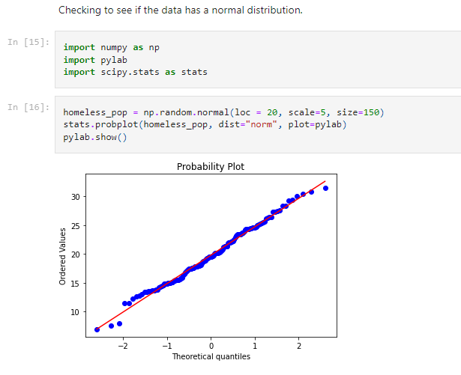
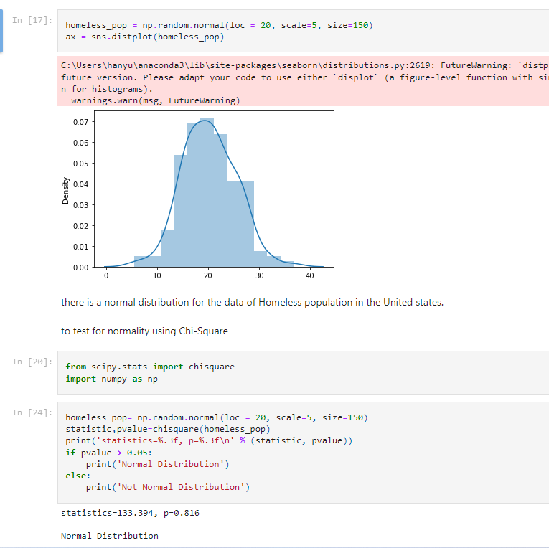
Data Wrangling
Notes:
Wrangling the massive amount of data included subsetting. Within our made subsets, there was a lot to uncover that needed assumption testing. Some of that included normal distribution which you can see on the right of the screen. Plotting is important for visualizing your data so we have done plenty of that.
Wrangle data for Homeless population from 2005-2020- checked to see if there was a normal distribution throughout the years.(Hanyury)

Slide 16
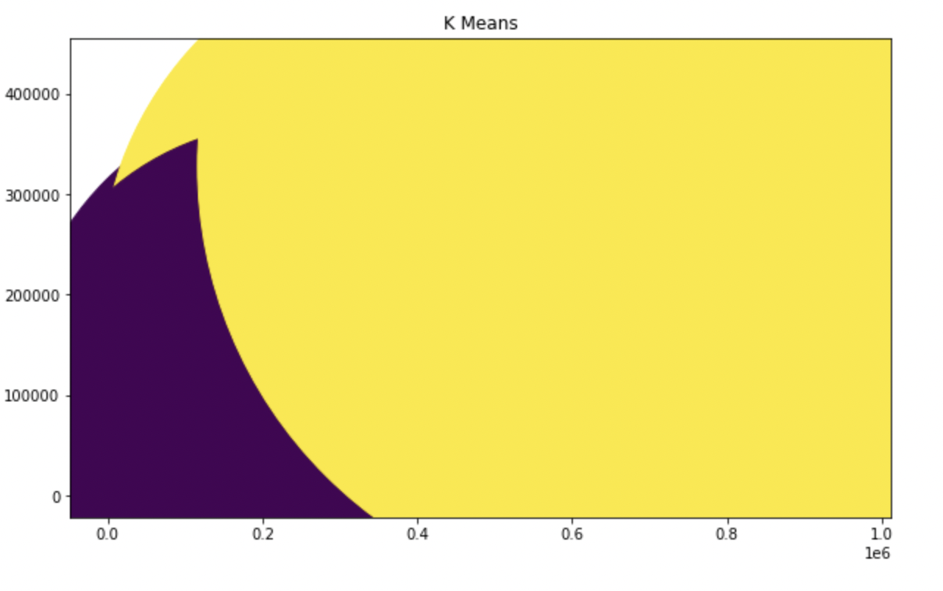
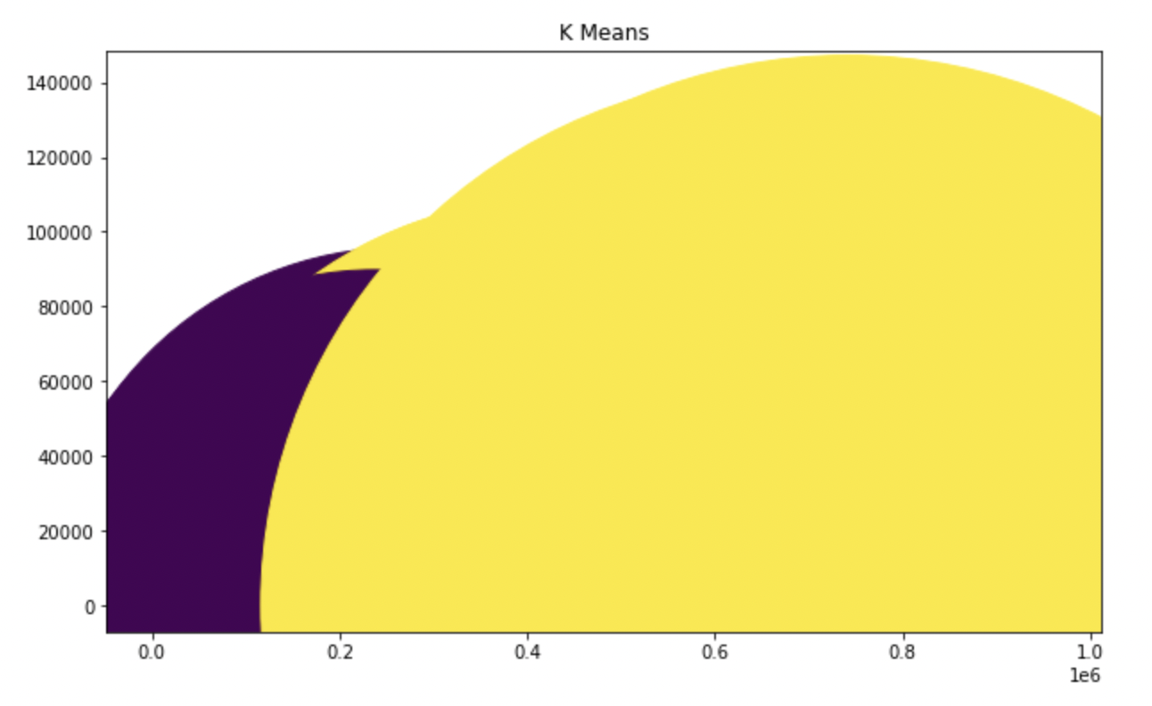
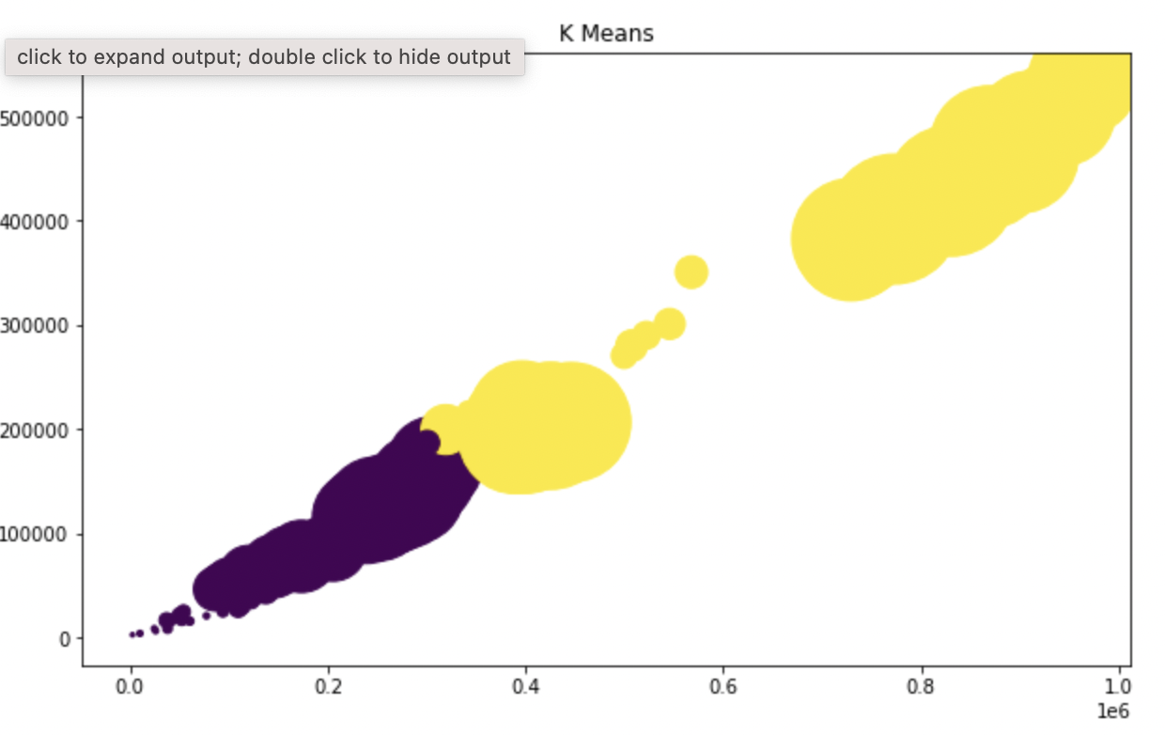
Data Wrangling
Notes:
Machine Learning was also utilized using K-Clusters here for Housing 2010-2021

Slide 17
Results

Slide 18
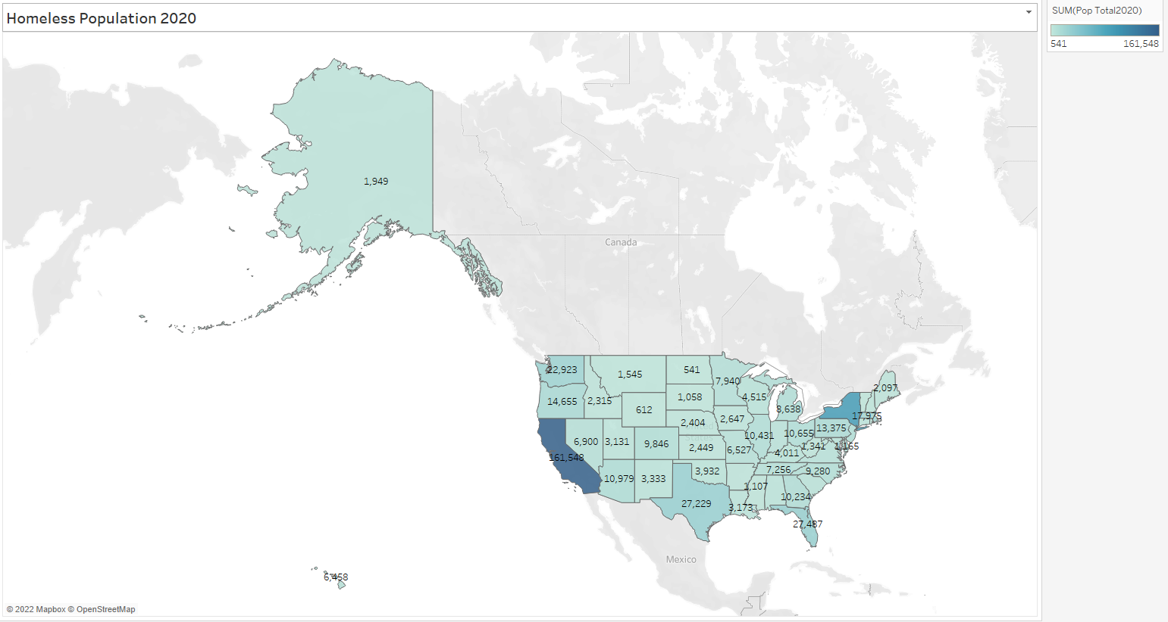
Notes:
Information is base on data from USAFacts taken on January end of the month.
Total numbers of Homelsseness base on each state from year 2020.
We can see that California, New York, Florida, Texas are some of the top states where the population is high.

Slide 19
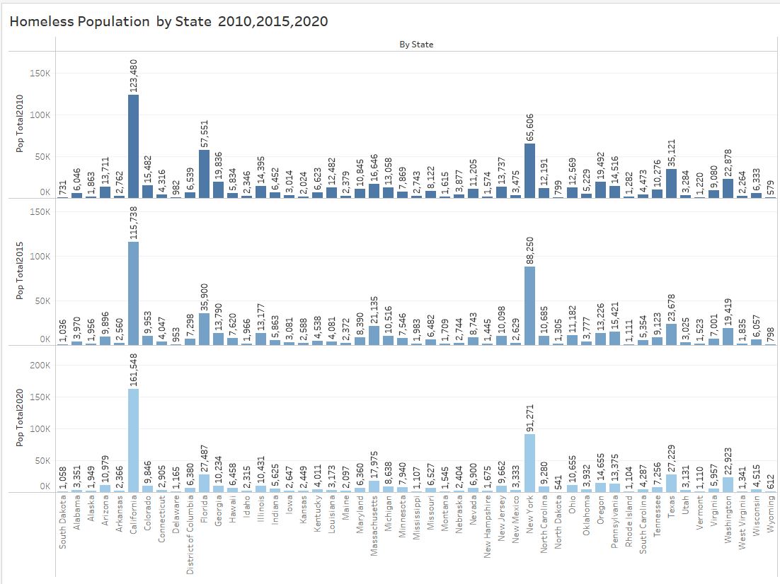
Notes:
A glimpse of national Homeless population Data for a Decade.
2015- more categorical data was added, ex. Gender, Age, Race
Top 3 states - California, Florida, New York
Bottom 3 States -North, South Dakota, Wyoming

Slide 20
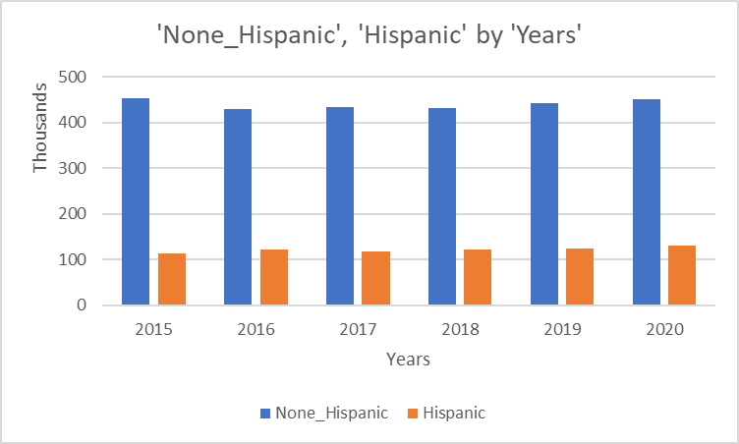
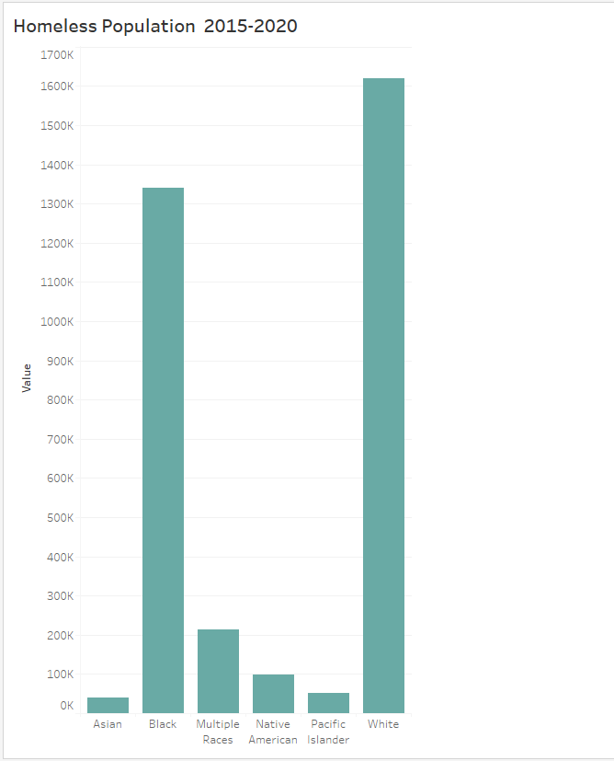
Race
Racial minorities experience homelessness at a disproportionate rate. For example, black or African Americans make up 13% of the general population but 40% of the homeless population.
Ethnicity
Almost a quarter of all people experiencing homelessness were Hispanic or Latino, with a similar rate in sheltered and unsheltered locations.
Notes:
Racial minorities experience homelessness at a disproportionate rate. For example, black or African Americans make up 13% of the general population but 40% of the homeless population.

Slide 21
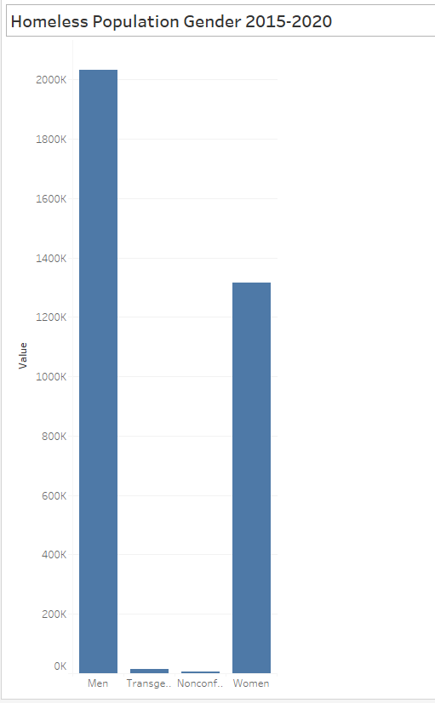
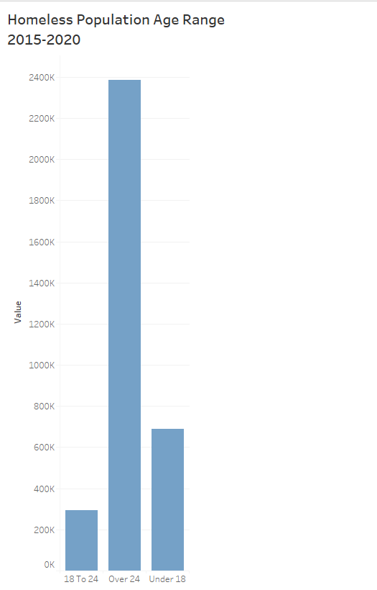
Gender
The gender characteristics of all people who experience homelessness reflected the high percentage of men in the individual adult segment of the homeless population.
61% of people experiencing homelessness were men, 39% were women, and less than 1% were considered transgender or gender-nonconforming.
Age
Across both sheltered and unsheltered types, nearly three-quarters of people experiencing homelessness were adults aged 25 or older
Notes:
Males are far more likely to experience homelessness than their female counterparts. Out of every 10,000 males, 22 are homeless. For women and girls, that number is 13. Gender disparities are even more evident when the focus is solely on individual adults (the most significant subgroup within homelessness). The overwhelming majority (70 percent) are men. (https://endhomelessness.org/homelessness-in-america/homelessness-statistics/state-of-homelessness-2021/)

Slide 22
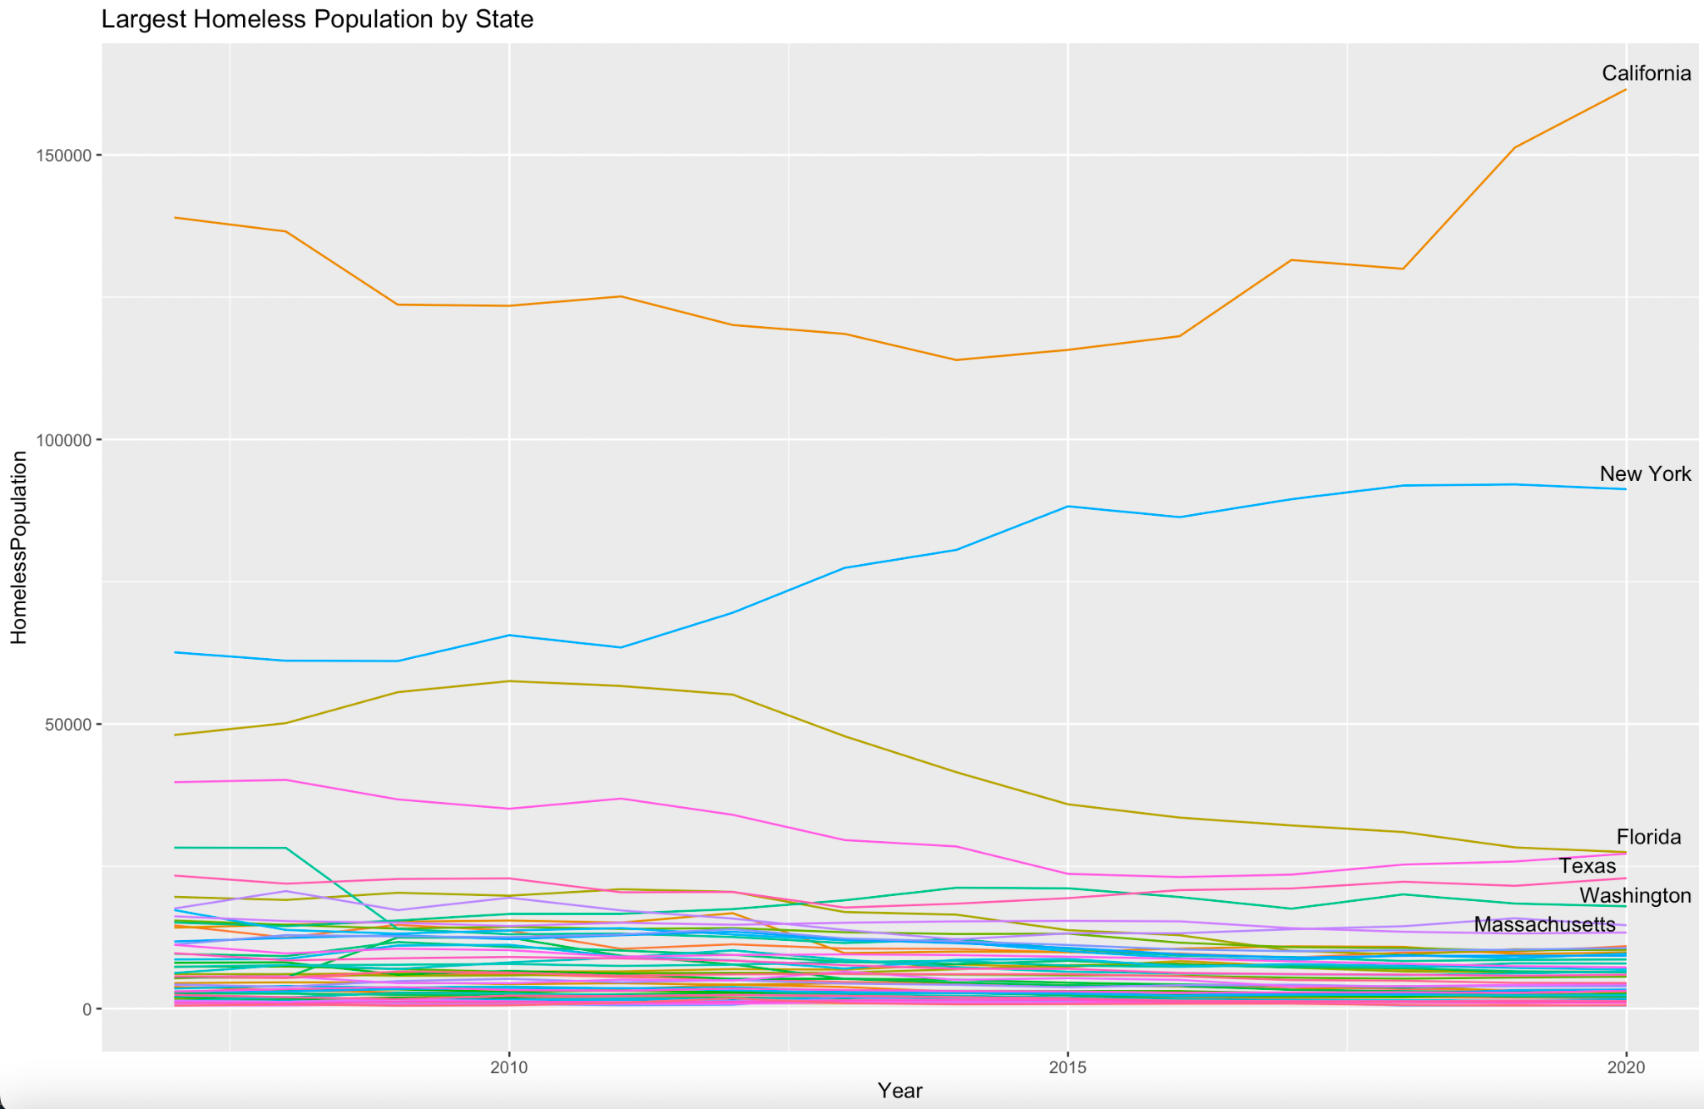
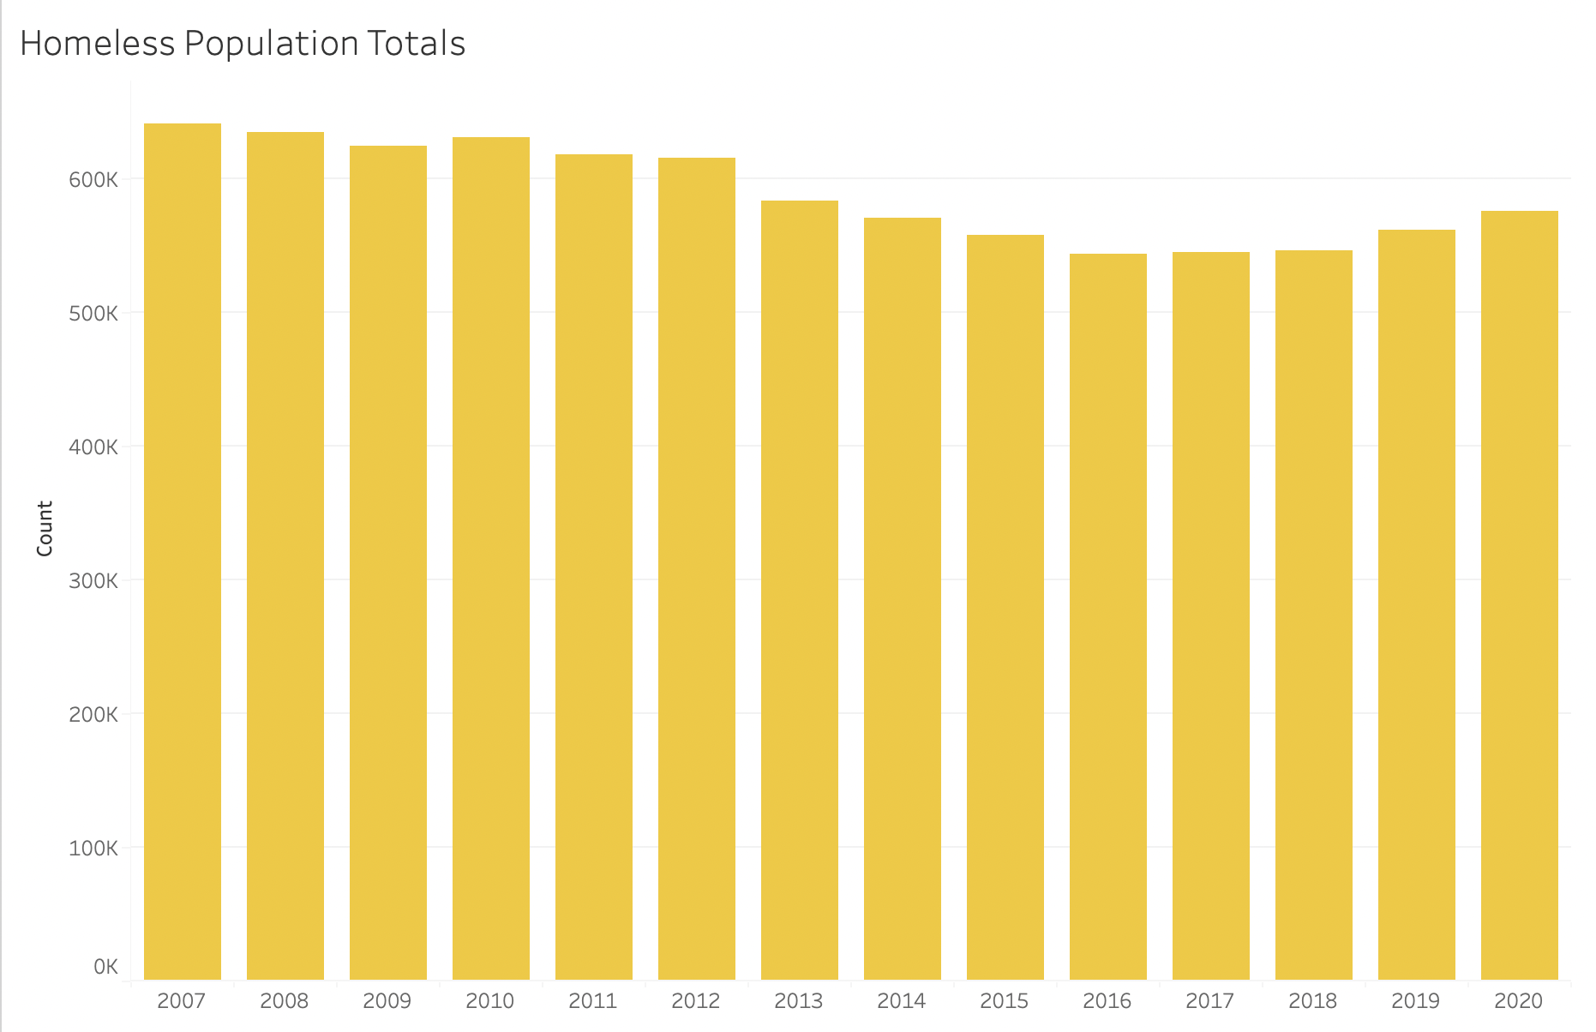
Homeless Population across the Nation
Notes:
We wanted to know what the Homeless Population looked like across the nation. What are our top states affected so we can further pick that apart as to why the numbers are so high there. We have California at a stunningly high population through the years, followed not so closely by New York, Florida and Texas. We see listed here Washington and Massachusetts but the 5th and 6th place were alternating through the years including in 2010, Georgia. But we focused our efforts on the more currently high populated states. This graph also shows that the numbers are not consistently uprising and we can’t see any particular pattern.

Slide 23
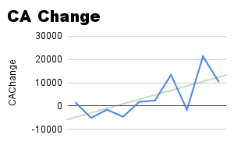
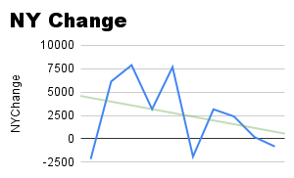
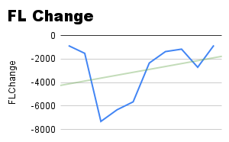
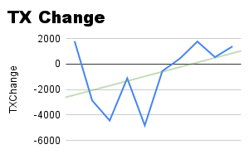
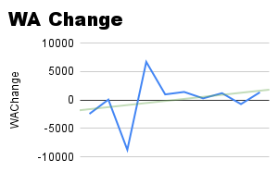
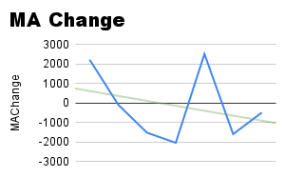
Homeless Population Growth Patterns
Notes:
These are trend graphs of the Top 6 States. We know that the homeless population is rising as whole, but it does not seem to ONLY be rising. There are a lot of waves in these numbers. You can see here that California, although trending positively for an increase are scaling down in some years. Same with all of them really except for Massachusetts, our 6th highest populated for the homeless. That state seems to be trending negatively. They just had a spike of about 4000 people between 2017 and 2018. Maybe we will see a downgrade in those numbers overall. New York also has a negative trend. Knowing that these states are truly all over the map, we obviously had to test it against the grand total population.

Slide 24
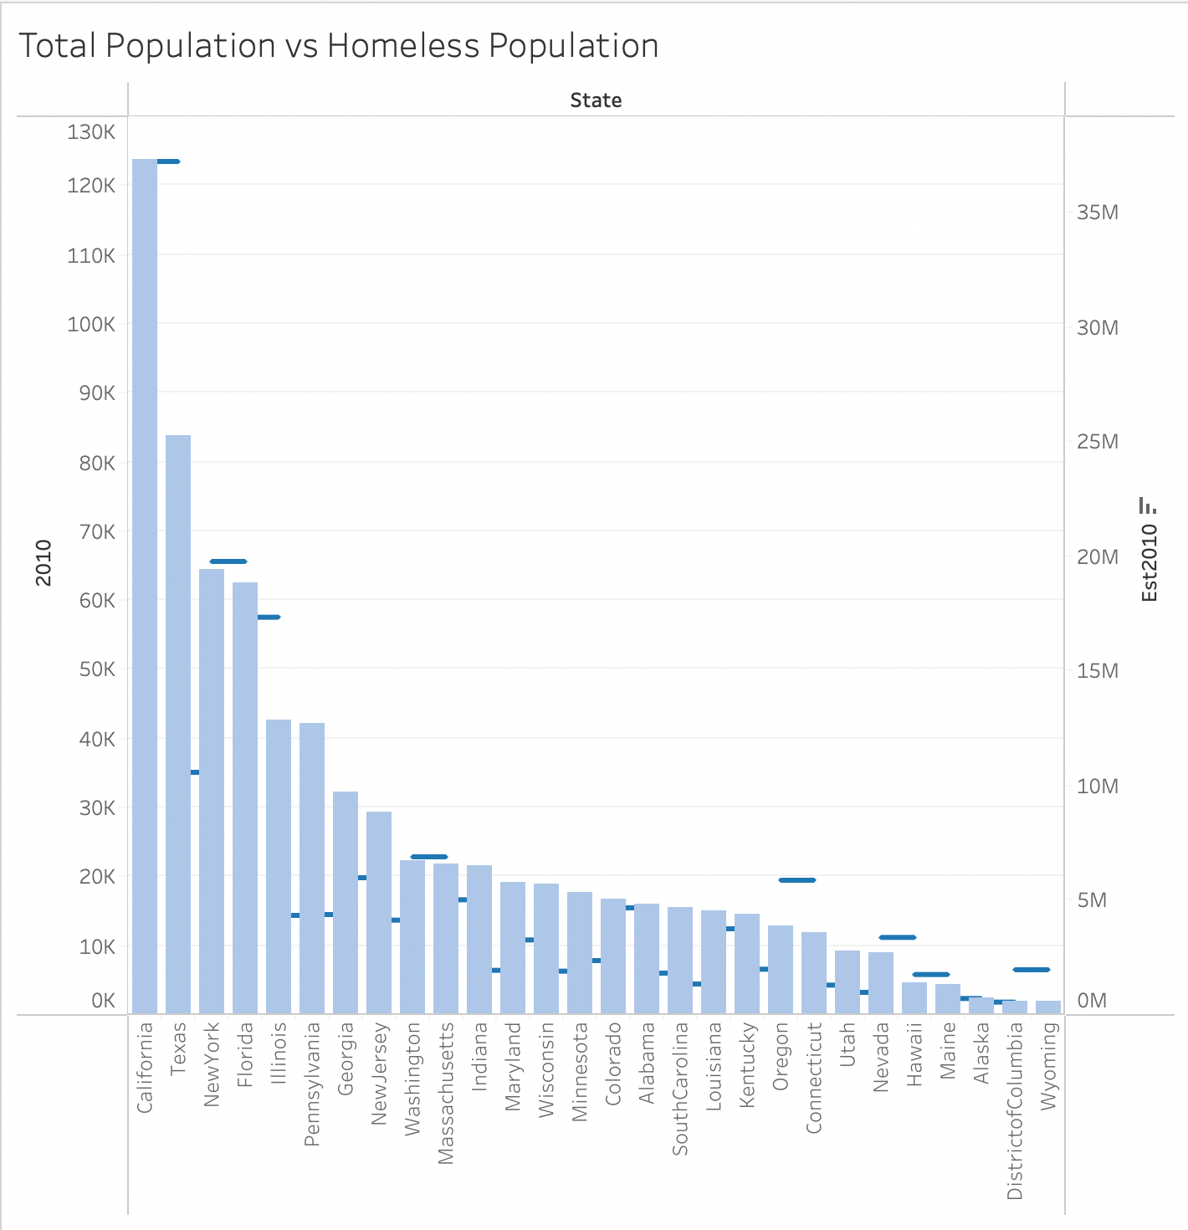
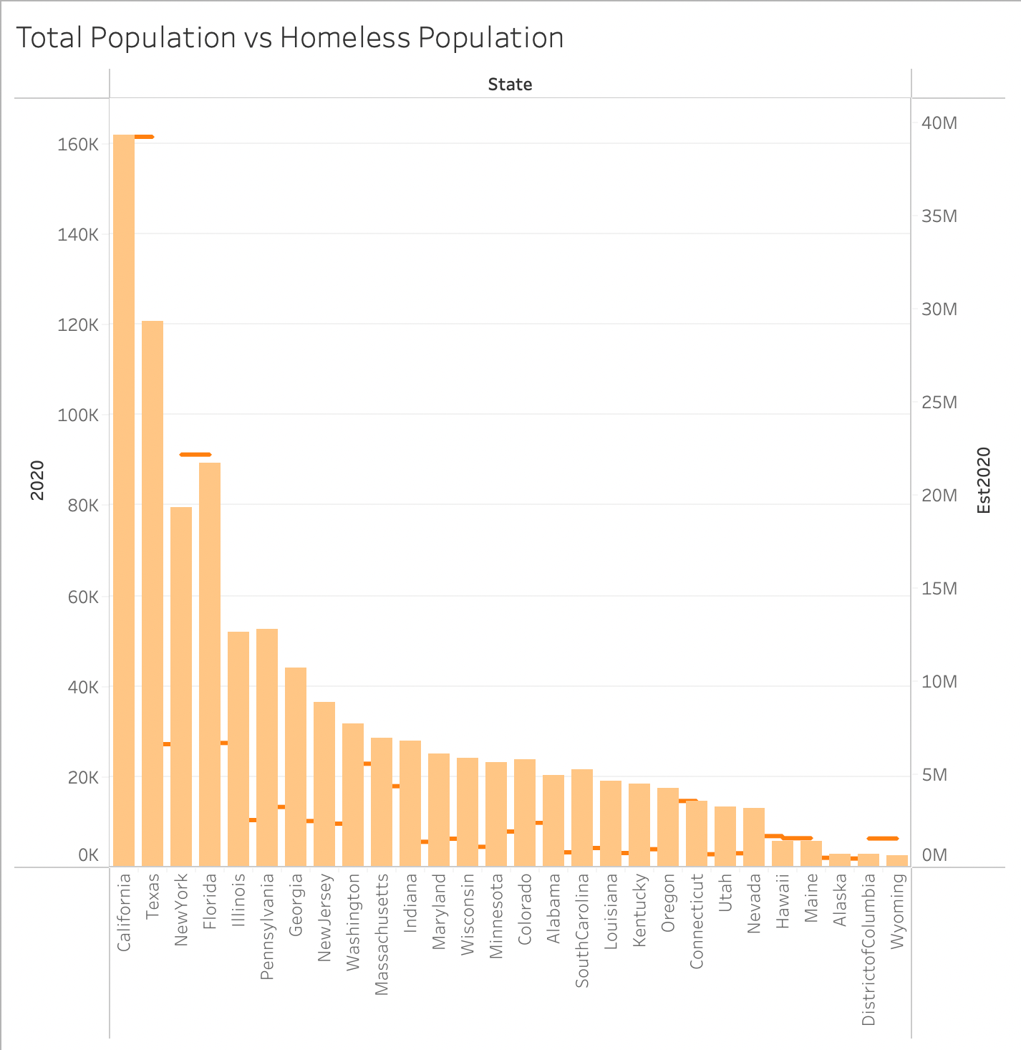
Total Population of the Nation
Notes:
Although we see certain states holding the Top 6 slots for homelessness, how do they compare to the states estimated total population? The United States population grows approximately .9% each year so are we simply largely populated with homeless persons because we are overpopulated in general? We see California is always the most populated state followed by Texas then New York, Florida, Illinois, and Pennsylvania. The homeless population does not trend the same way, so we know that there is some sort of cause besides simply just a lot of people around. I have singled out some choice states that support this. If you see in the blue graph, that is 2010’s numbers compared. There are a couple states with their ratios completely out of whack with what would be considered a high homeless population. You’ll see Oregon as a main example of that. When it comes to the 2020 numbers, we see the same a change, but not a trend. I’d say just by looking at the ticks, we have an overall leveling out in most states and a steady increase in others like our Top 6. I’d say the most we can take away from these numbers are the high increase in total population.

Slide 25
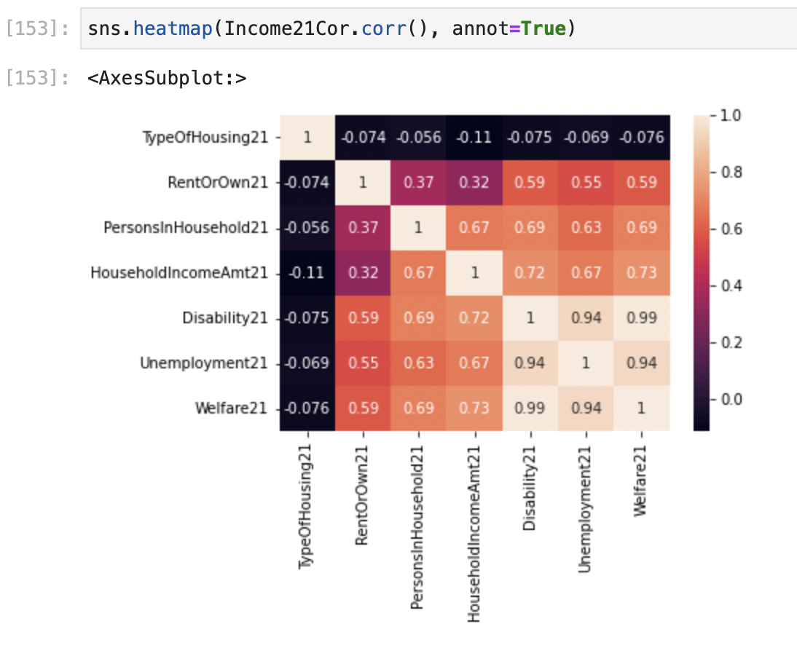
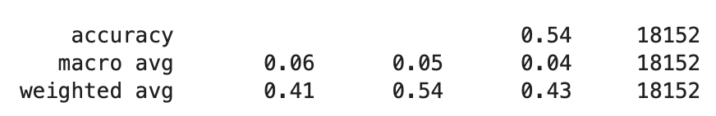
Can we deduce any predictions?
Notes:
Here I have one of the correlation heat maps done of factors of 2021 income. This tells us that we do have some potential correlations between mainly the homes where we have residents on disability, welfare and claimants of unemployment, BUT do we have causality?? I ran these factors, through a random forest test to determine if there was a model to help predict. Based on the random forest, we are resulting in a 54% accuracy for the model. Based on the amount of data, it should give us an extremely accurate model. Generally, the larger the dataset, the more accurate. We have 18,152 entries, so this tells us that it is going to be nearly impossible for any of the variables to accurately predict what will be the future household income. We know this to be one of the major contributors to homelessness, so being that we cannot predict it, we will not be able to deduce it as a factor for growing nor decreasing homeless population. At this point, it would be skepticism and not accurate assumption.

Slide 26
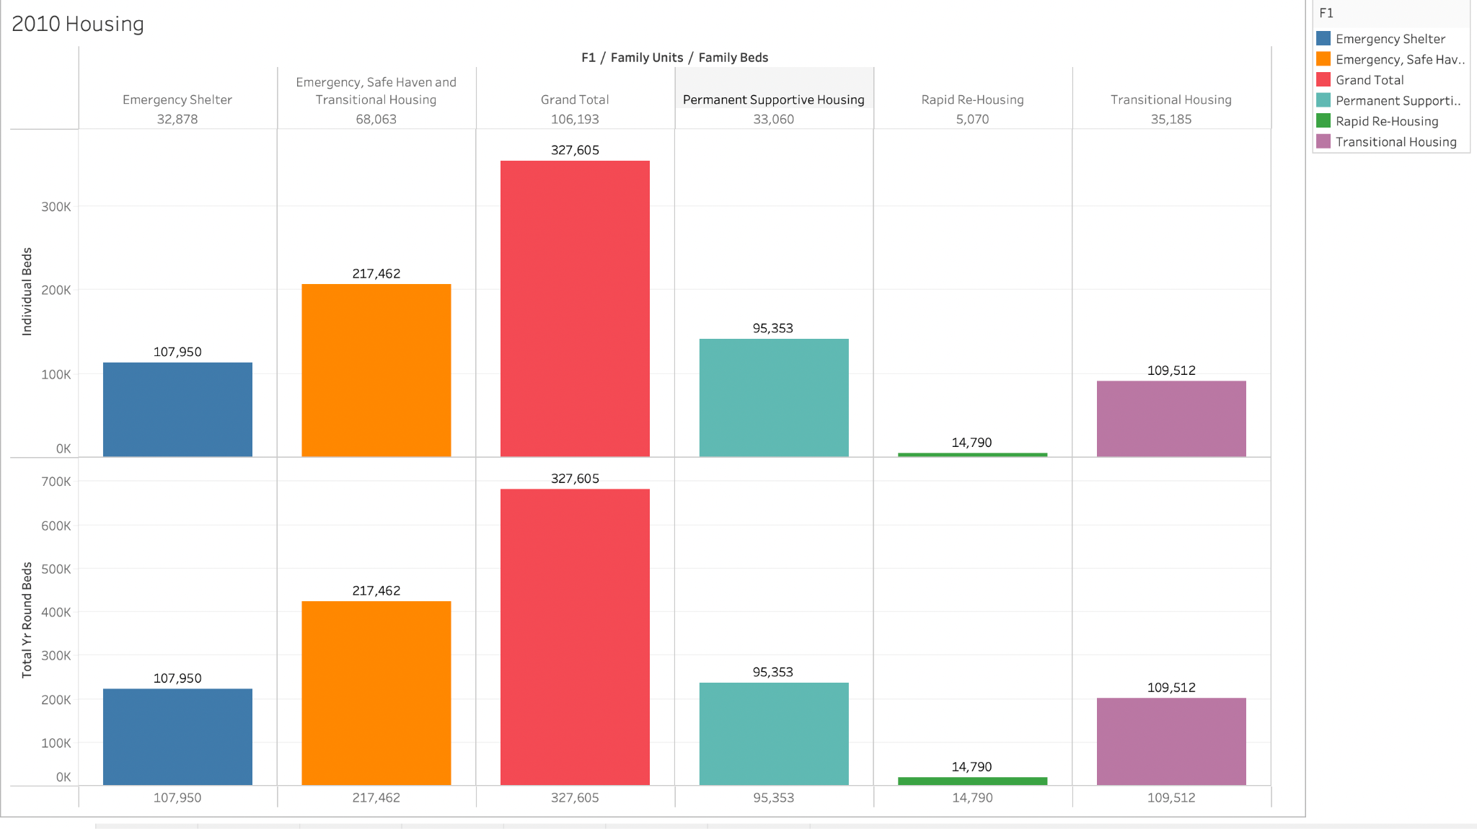
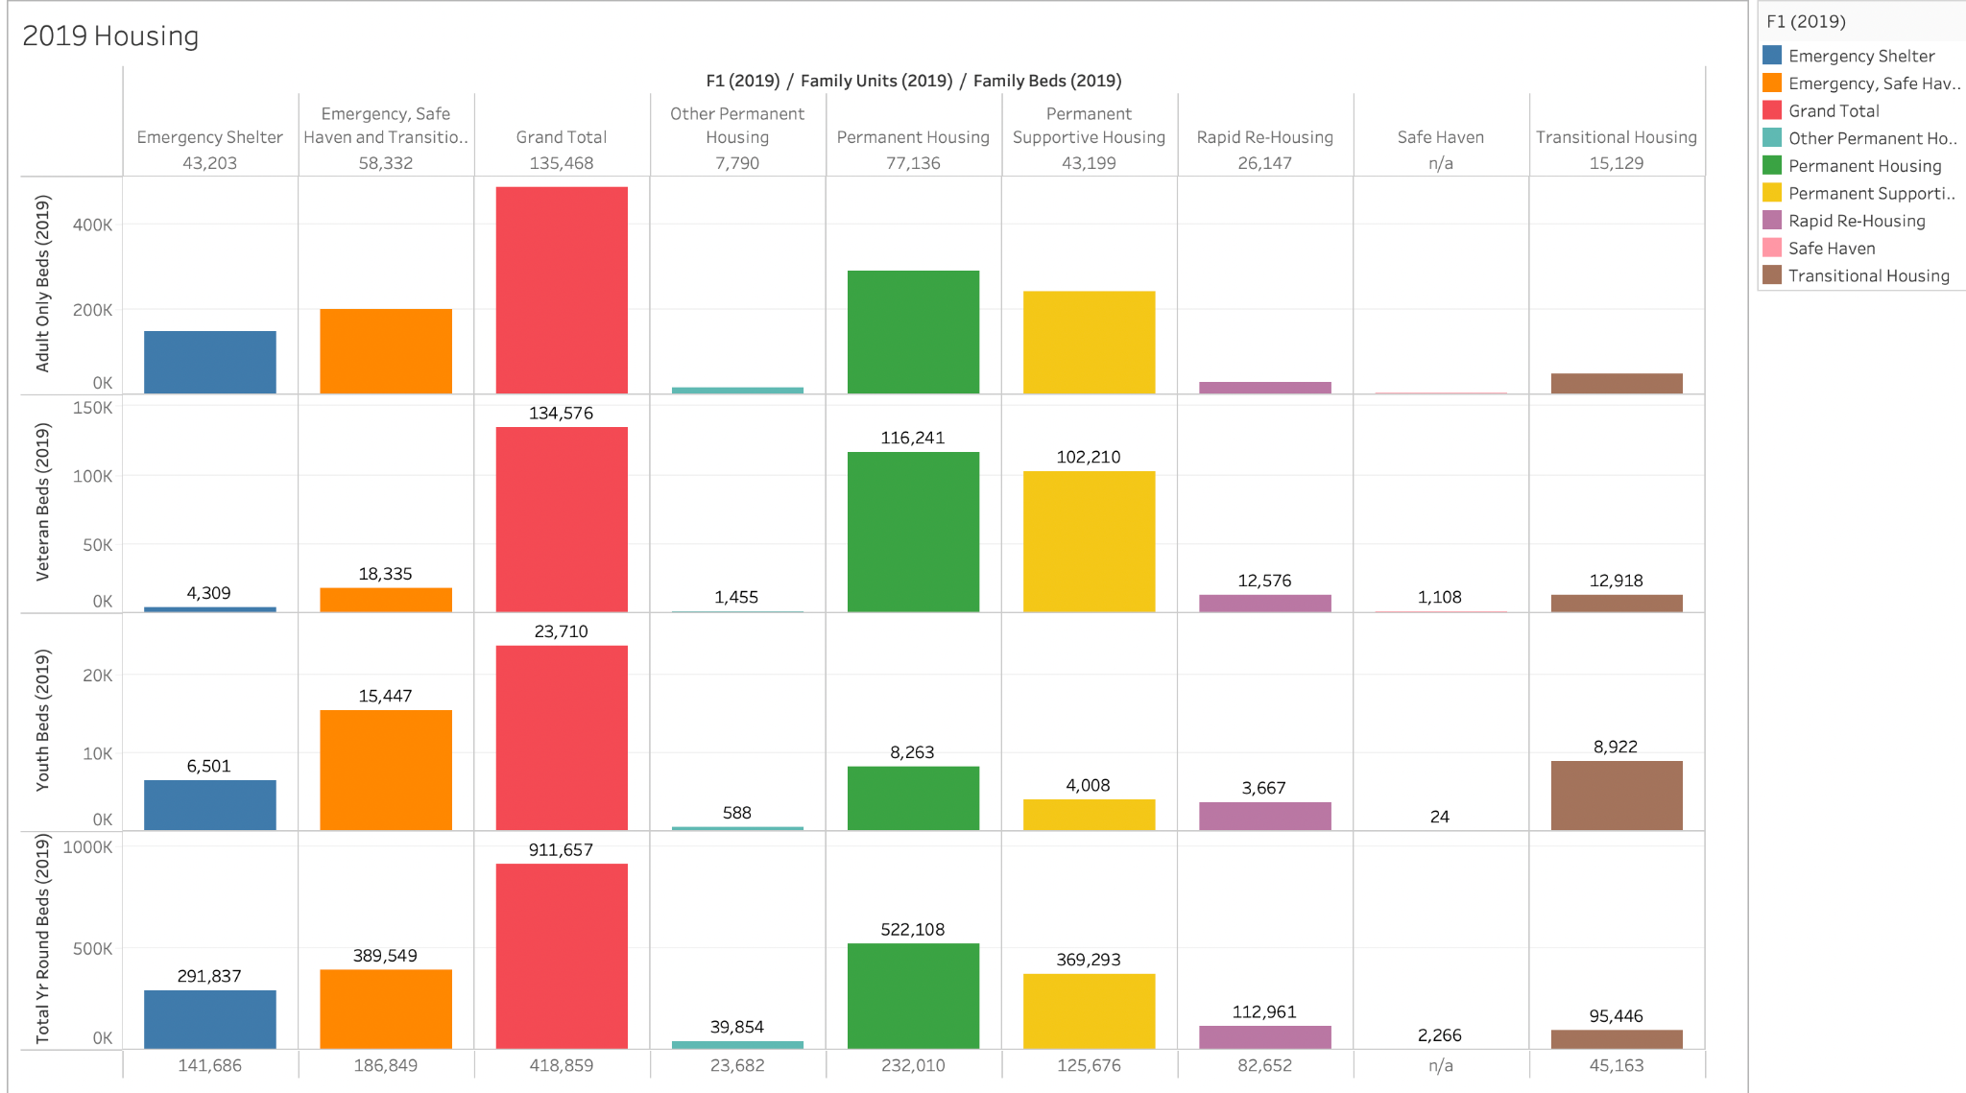
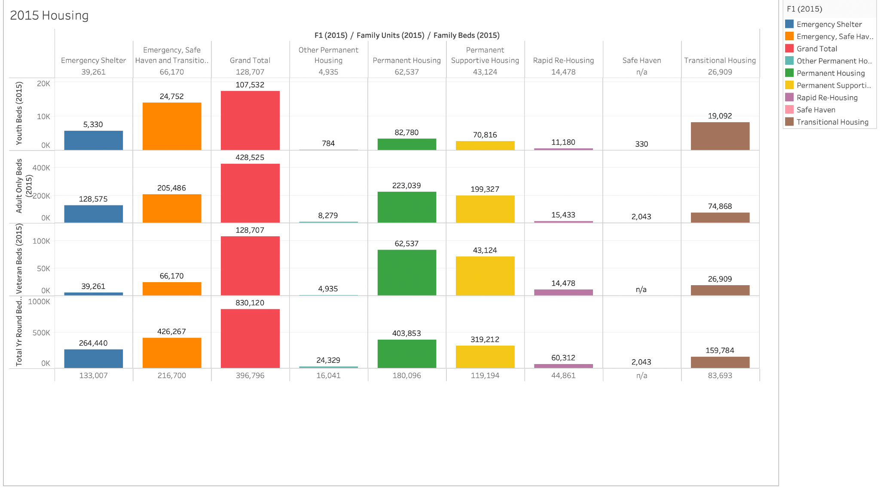
Housing Availability 2010-2015-2019
Notes:
What options do the homeless have to assist them with having a safe place?
Emergency Shelters- These facilities are often the first place people turn to during or after experiencing an economic or domestic crisis. Emergency shelters provide support services and short-term stabilization for individuals and families before finding appropriate housing that meets their long-term needs.
Transitional Shelters- provide temporary residence, ranging from six to 24 months for people experiencing homelessness. Transitional shelters typically include supportive services to improve employability, to further help individuals obtain permanent housing as quickly as possible.
Rapid Re-Housing- provides assistance to help individuals and/or families find a home of their own as quickly as possible. It is a housing first solution for non-chronic homelessness where individuals or families rent an apartment of their own and are provided temporary community support services which can include case management and time-limited financial assistance, with the goal to bring them quickly out of homelessness.
Permanent Supportive Housing- is a program designed to provide housing and supportive services on a long-term basis to formerly chronically homeless* people. These are individuals who have a diagnosed disability and who have been continuously homeless for one year or more.
Safe Havens- serve as refuge for people who are homeless and have a serious mental illness. Safe Havens provide more than shelter. They close the gap in housing and services available for those homeless individuals who, perhaps because of their illness, have refused help or have been denied or removed from other homeless programs.

Slide 27
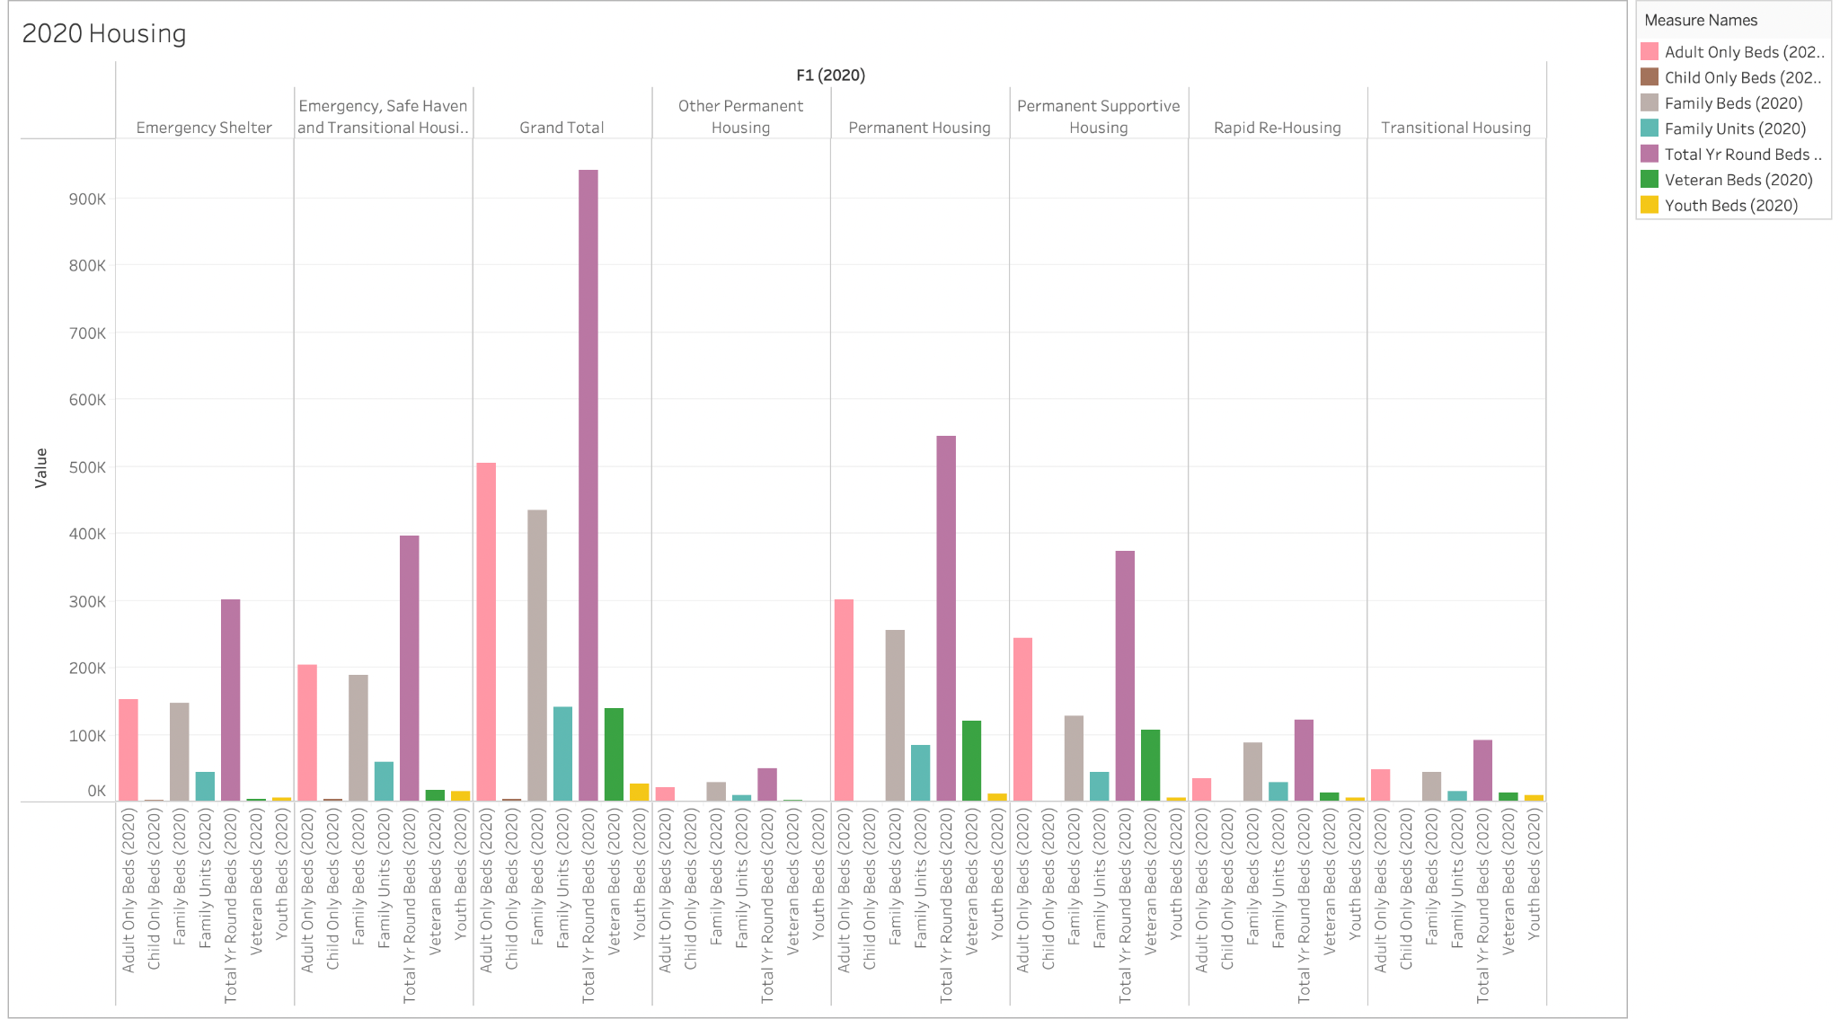
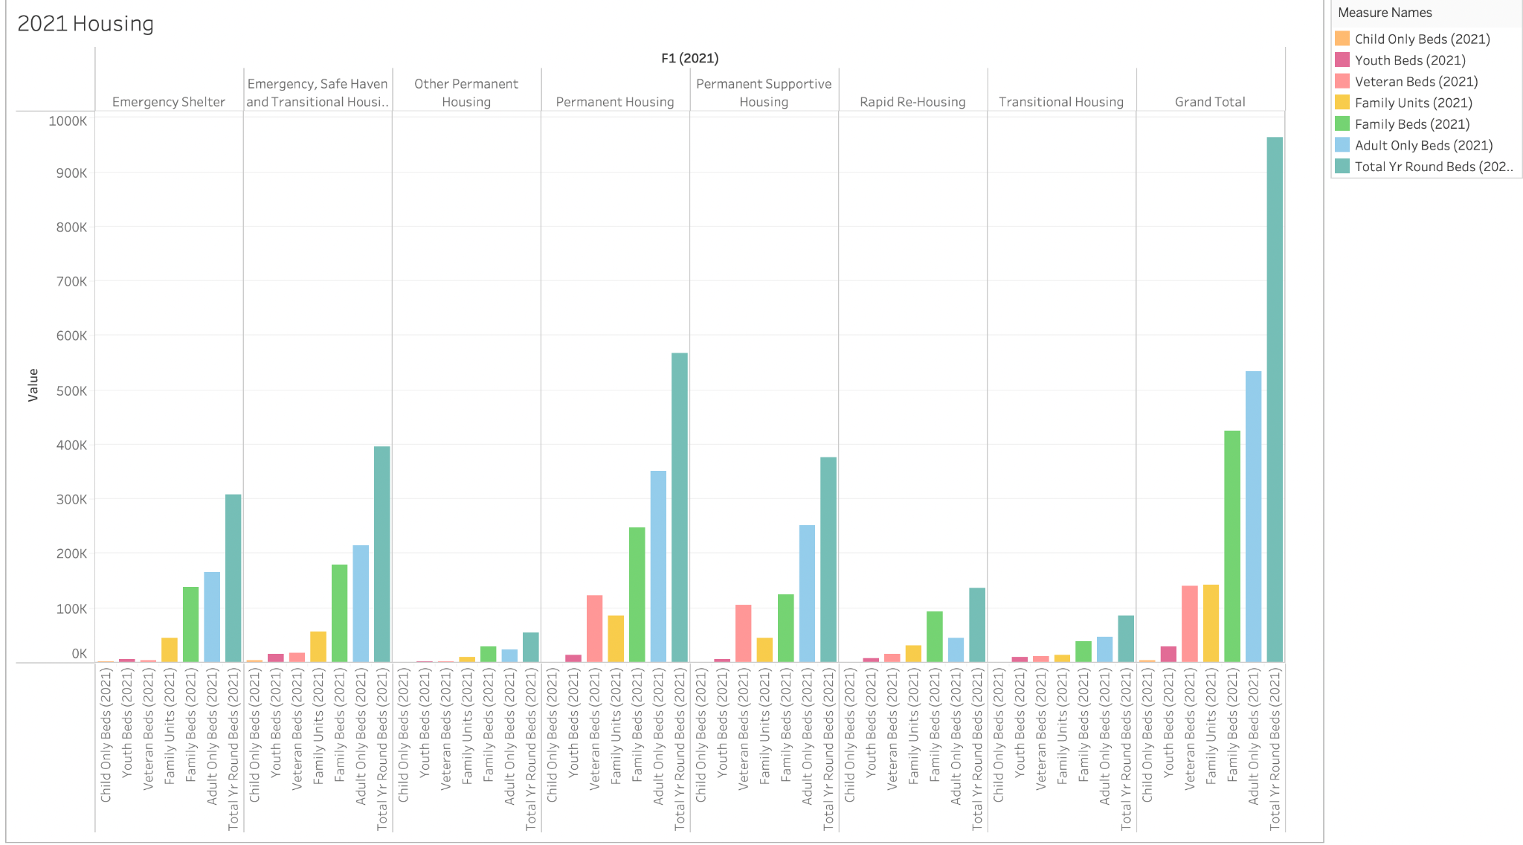
Housing Availability 2020-2021

Slide 28
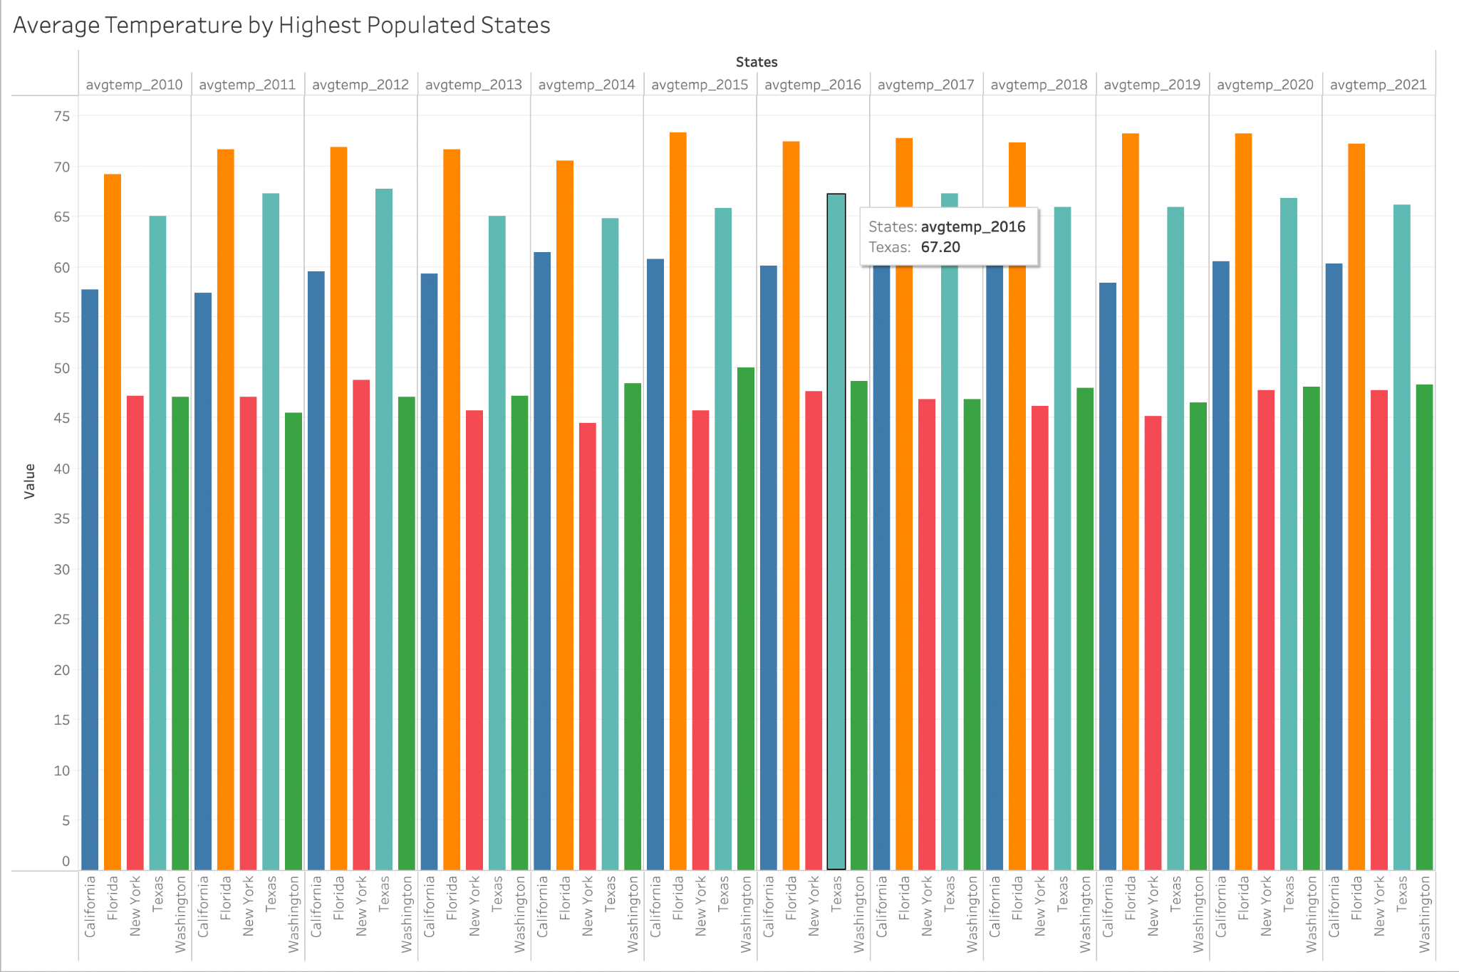
Average Temperature in Highest Populated States 2010-2021
Notes:
We are now looking at the average temperature for California, Florida, New York, Texas and Washington, which are the highest populated states. New York has the lowest annual average temperature and Florida has the highest.
How has weather and/or climate affected the US homeless population?
Consider yourself as being homeless, I would think you would want to have the most perfect weather as possible. California is the number 1 highest populated state with homelessness. If you had to be homeless, why not be in a state that has an average of 65 degrees fahrenheit and also a state that barely gets precipitation. It’s also a great location being that it borders the Pacific. New York is the 2nd most populated state with homelessness. They’re average temperature is 45 degrees fahrenheit. Although there are laws in just about every state criminalizing homelessness, it’s hard to control in highly populated areas.

Slide 29
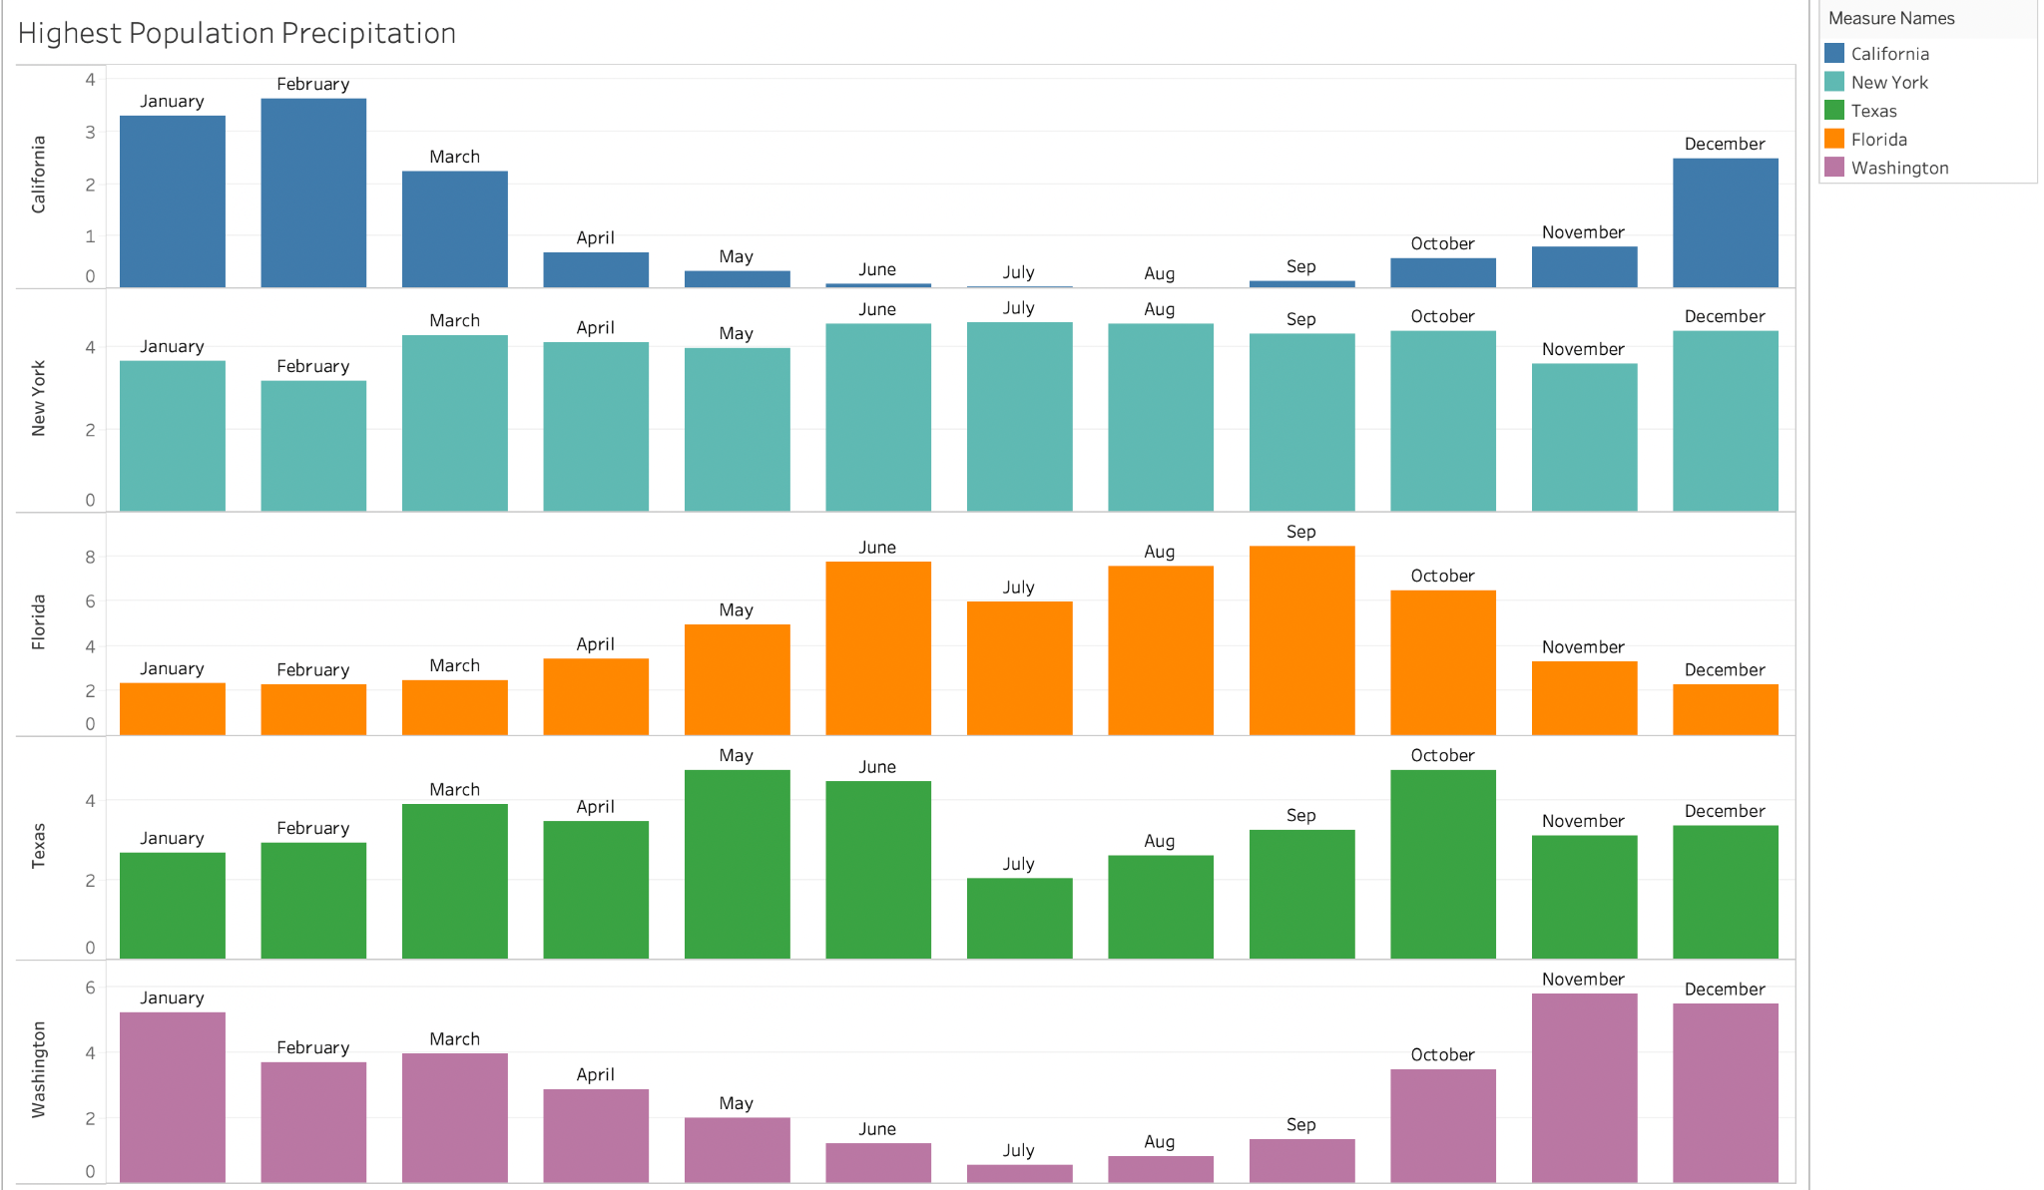
Precipitation in Highest Populated States 2010-2021
Notes:
This slide is based off the highest populated states from 2010-2021. It shows the precipitation rate for California, New York, Florida, Texas and Washington. Based off our data, we can see that the state of California has the lowest precipitation rate. Also notice Florida’s values are set a little different. The values go up to 8. Florida has the highest precipitation of these five states.

Slide 30
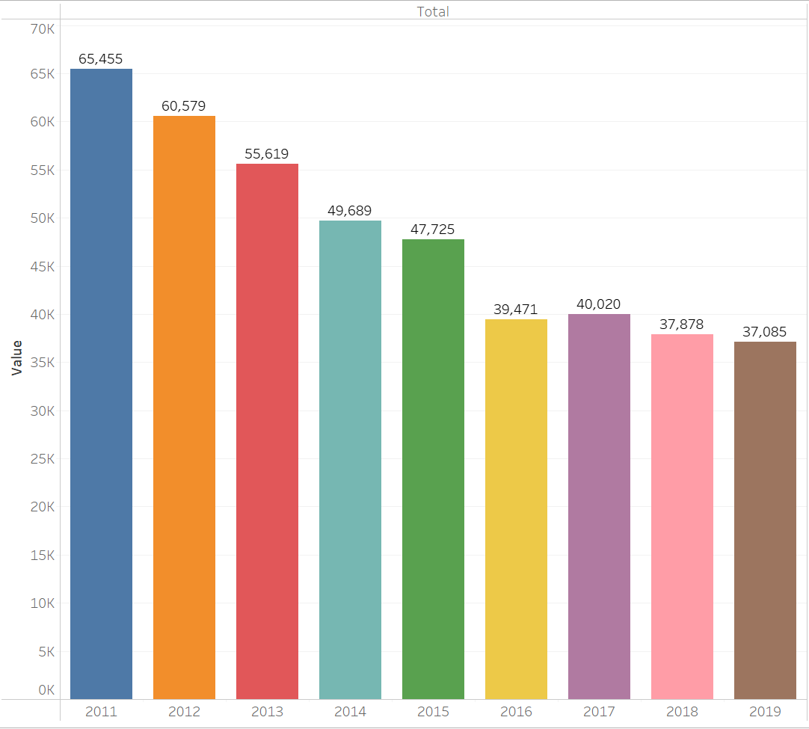
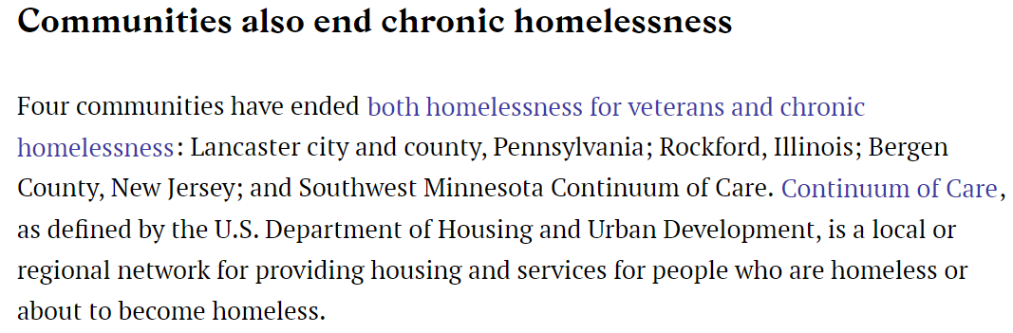
Notes:
Looking at the bar chart that was created based on data found, Homelessness in the Veteran Community has decreased over time. According to a source, there are communities that are working together to end Homelessness across the nation.
Source: 50 Facts About Homelessness in America | Stacker

Slide 31
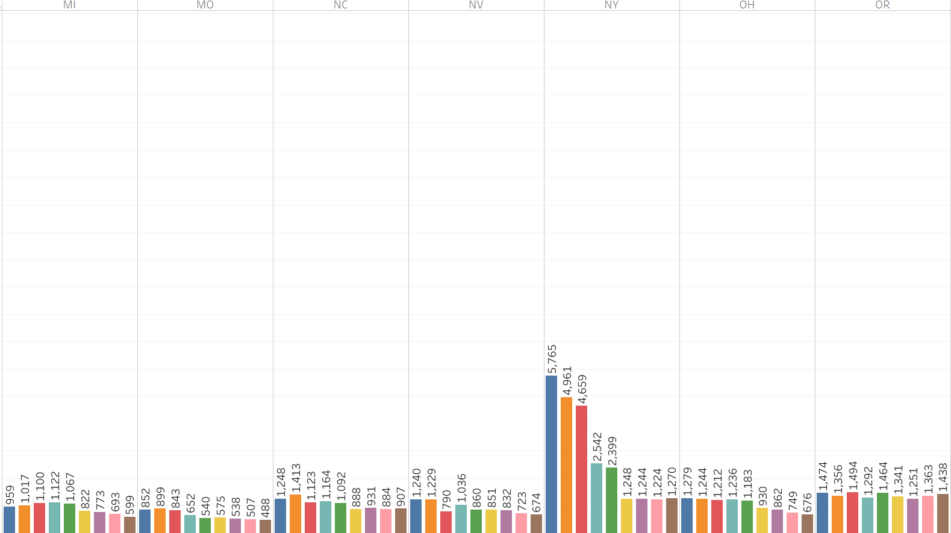
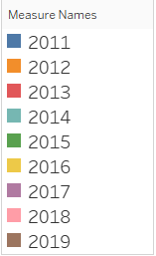
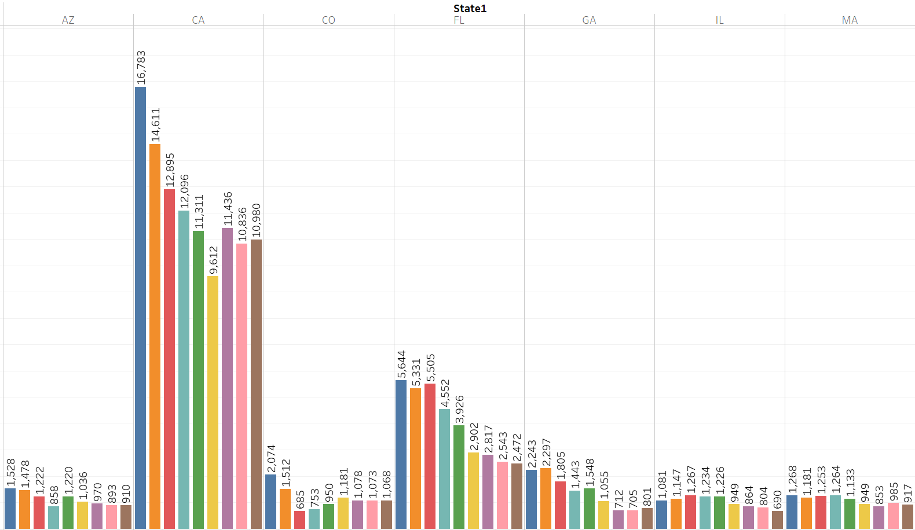
TOP STATES OF VETERAN HOMELESSNESS BETWEEN 2011-2019
Notes:
Veteran Homelessness was very HIGH in California, Florida, New York, Texas, and Washington.
Followed by other states that were in the HIGH-LOW range. Those states are Arizona, Colorado, Georgia, Illinois, Massachusetts, Michigan, Missouri, North Carolina, Nevada, Ohio, Oregon, Pennsylvania, Tennessee, and Virginia. (continue on next page)

Slide 32
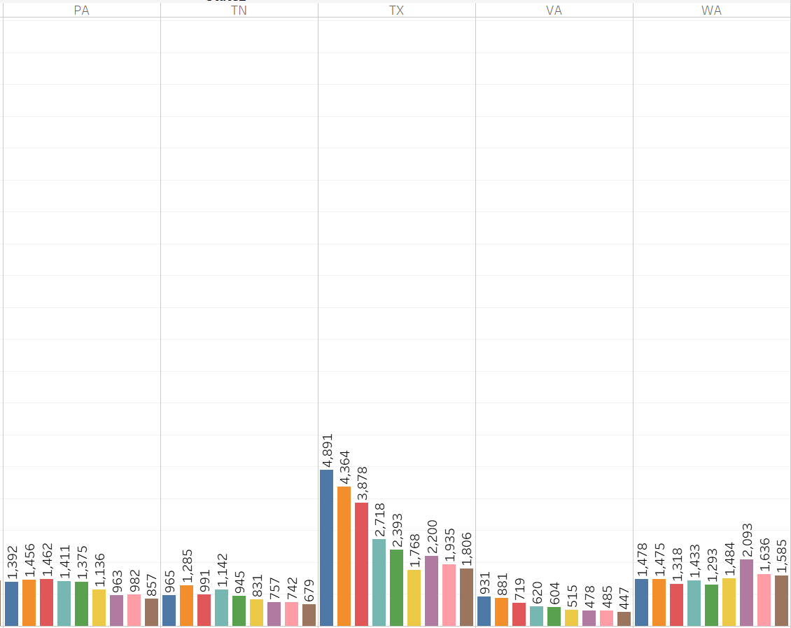
TOP STATES OF VETERAN HOMELESSNESS BETWEEN 2011-2019 (continue)

Slide 33
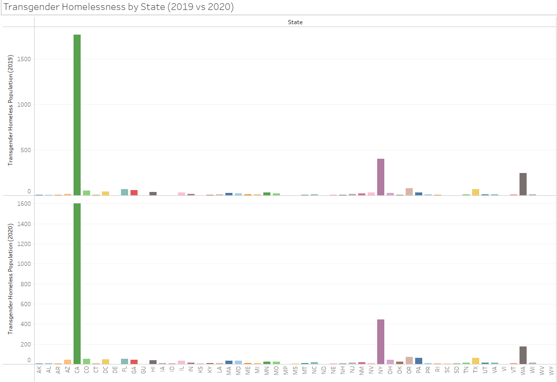

Slide 34
Major Transgender Homelessness Findings
⦿ 0.5% of the general United States homeless population are transgender
⦿ New York and California consistently have the highest transgender homeless population
⦿ Of the 0.5%, 63% are unsheltered
⦿ Over 53% of homeless transgender African Americans have reported being attacked while homeless
⦿ 40% of homeless youth are LGBT+, while the general youth population
is only 10% LGBT+
⦿ LGBT+ youth are roughly 7.4 times more likely to experience acts of sexual violence than their heterosexual homeless counterpart

Slide 35
Summary

Slide 36
What are the demographics of the people most affected?
Over all the demographic that is most affected are Men, who are over 24 years of age, and making the African American Community to be the most at risk to experience homelessness.
What is a large contributor to the growing numbers of homeless persons in the US?
This is still definitively inconclusive.
Is housing/shelters available for the homeless population? If so, What kind?
Housing/shelters are available for the homeless, according to the data. There are several different shelter types available including women shelters, transitional housing, permanent housing and emergency shelter.
How does weather affect the homeless population?
Weather plays a vital part in the homeless population. People experiencing homeless describe adverse health impacts more from extreme cold, than extreme hot weather. They consider their health suffered more, because of wet bedding, clothes and shoes.
How has the Veteran Homeless population changed over the years?
Of the years that were examined, the Veteran Homeless population has definitely decreased over the years. Hopefully in years to come, it will continue to decrease not only for the Veterans, but for the homeless population overall.
What percentage of the U.S. homeless population is transgender and or gender non-conforming?
0.5% of the general United States homeless population are transgender, making the transgender community a minority within the data. Although a small percentage of homeless people are transgender, this is still thousands of people with more than half of them being unsheltered.

Slide 37
Conclusions
With this analysis of Homeless Population in the United States, we can conclude that the severity of this issue is ongoing, and that there are many factors that contribute to an individual who experiences homelessness.
Homelessness is not just attributed to those who experience metal illness but also people from different backgrounds, financial stability levels, sexually abuse, gender, and families.
States with a larger population have more housing resources available for those facing homelessness.
Nearly every states has laws criminalizing homelessness. However some states feel that criminalizing the homeless causes more problems by creating additional barriers to housing and employment.
The Veteran communities are working together to make sure the men and women who have fought for our country are never alone.
The LGBT+ homeless community are more likely to be the victims of sexual violence

Slide 38
Any questions?

